Slide 1

Scout Rescue
3D Vision and IMU-Aided Turtlebot Recovery
Team #12 X
Frank Jin, Haotian Jiang, Jonas Li, Santiago Ramirez
*sort alphabetically

Slide 2
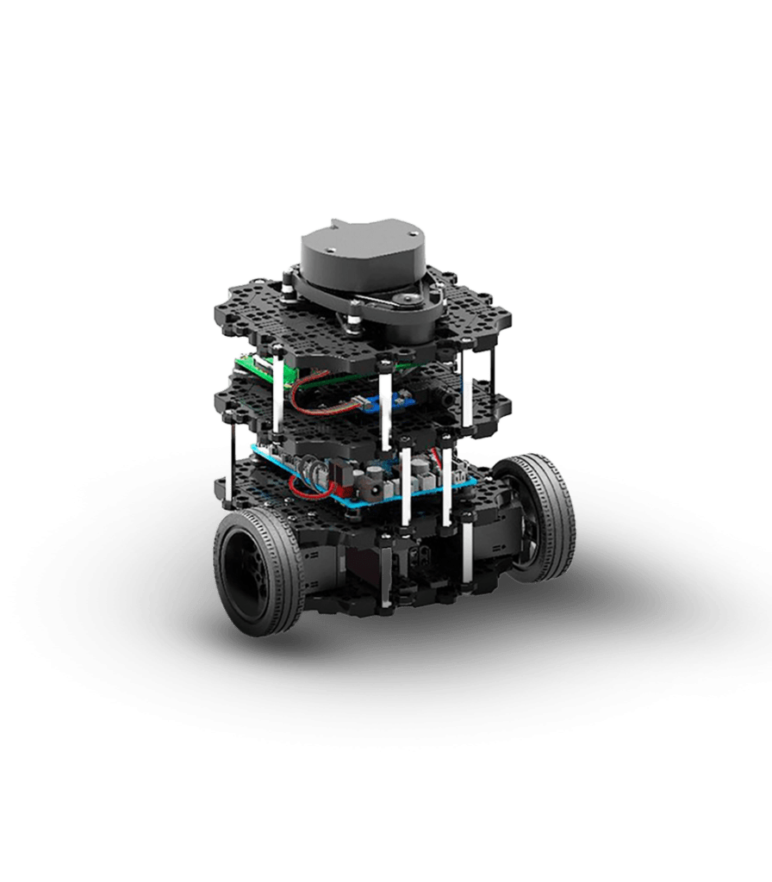
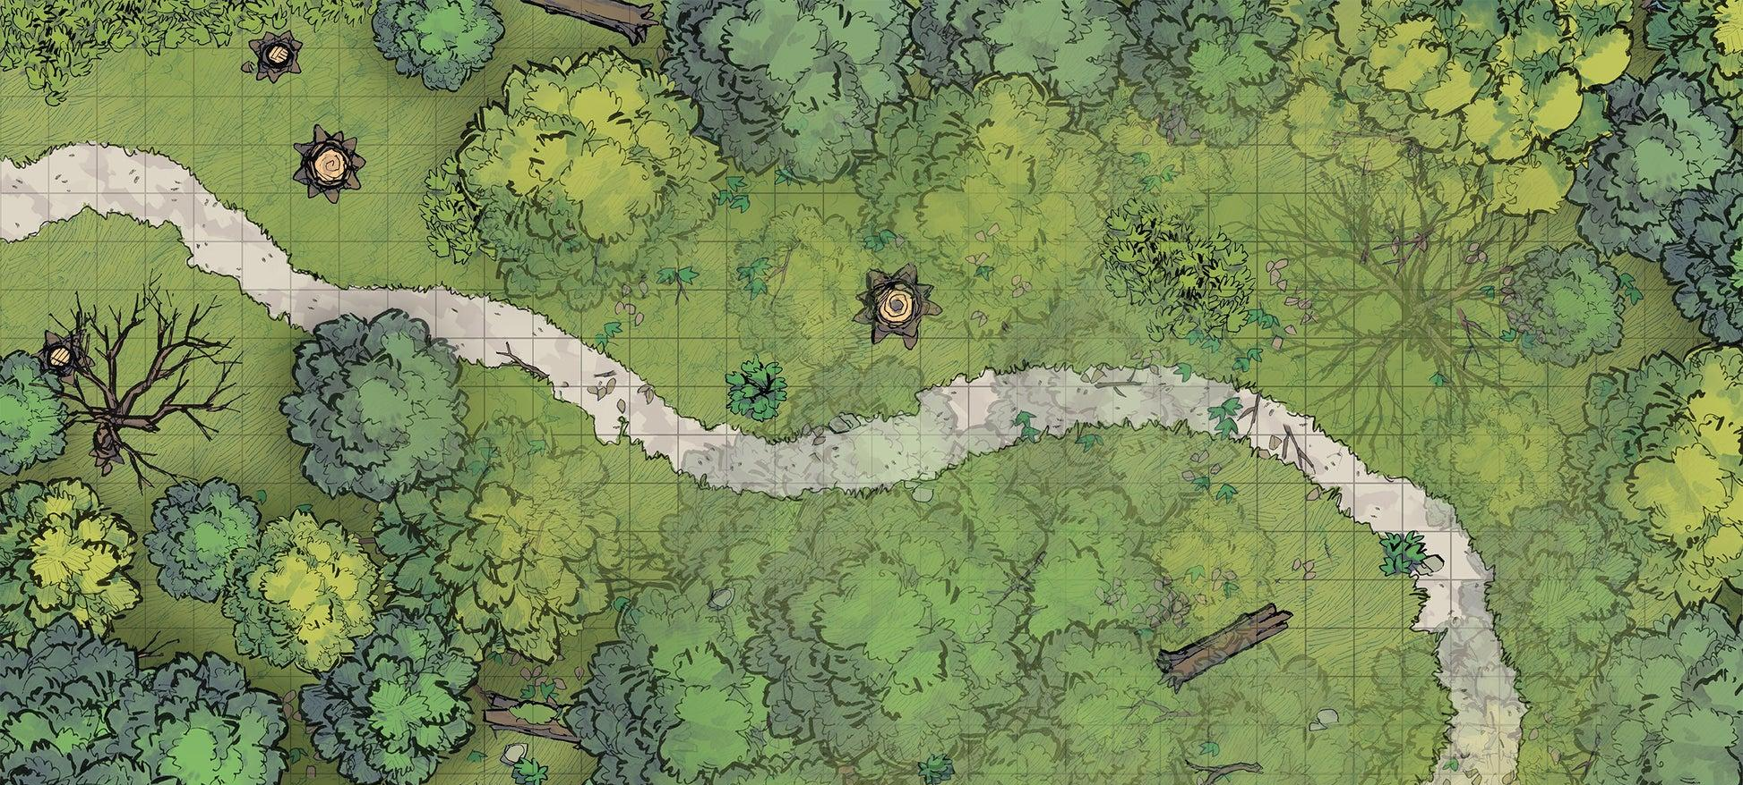
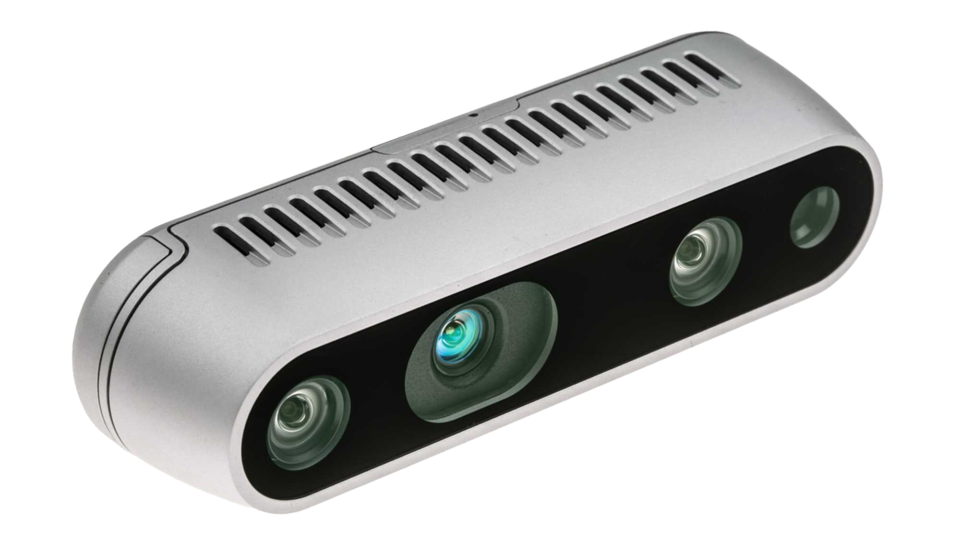
Original Goals
① Scout
Notes:
Image you have a Turtlebot as a scout, it’s on the way to learn the lay of the land. As it’s exploring, a fatal error in its camera feed occurs (eg: a connection has gotten loose and the Turtlebot can’t fix it itself). To solve this we deploy a secondary Turtlebot to find the scout Turtlebot, based on the information the scout has already collected and the last image it was able to capture.

Slide 3

Original Goals
① Scout
Notes:
Image you have a Turtlebot as a scout, it’s on the way to learn the lay of the land. As it’s exploring, a fatal error in its camera feed occurs (eg: a connection has gotten loose and the Turtlebot can’t fix it itself). To solve this we deploy a secondary Turtlebot to find the scout Turtlebot, based on the information the scout has already collected and the last image it was able to capture.

Slide 4
Original Goals
② Rescuer
① Scout
Notes:
Image you have a Turtlebot as a scout, it’s on the way to learn the lay of the land. As it’s exploring, a fatal error in its camera feed occurs (eg: a connection has gotten loose and the Turtlebot can’t fix it itself). To solve this we deploy a secondary Turtlebot to find the scout Turtlebot, based on the information the scout has already collected and the last image it was able to capture.

Slide 5
What We Are Doing
Data Storage
Local Host
IMU Data
Map
Scout bot last Image
Perception: Feature Matching
Planning
Localization: 3D SLAM
Software
Open Platform
IMU Replay
Camera Failure Detection
Runtime Framework: ROS
Hardware
Reference Platform
Realsense D435i Camera
HMI
IMU
LiDar
Raspberry Pi 4
Mobile Robot
Reference Platform
Turtlebot
Figure 1. System design overview
Notes:
[System design and operation diagram]

Slide 6
What We Are Doing
Confirm by user
HMI
Pick keypoints and Display
Perception
Planning
Control
Feature Matching
Localization
Data Storage
IMU Replay
Visual SLAM
Map
IMU
Data lines
Camera Failure Detection
Figure 2. Core workflow of second turtlebot
Control lines
OFF
Notes:
[System design and operation diagram]

Slide 7
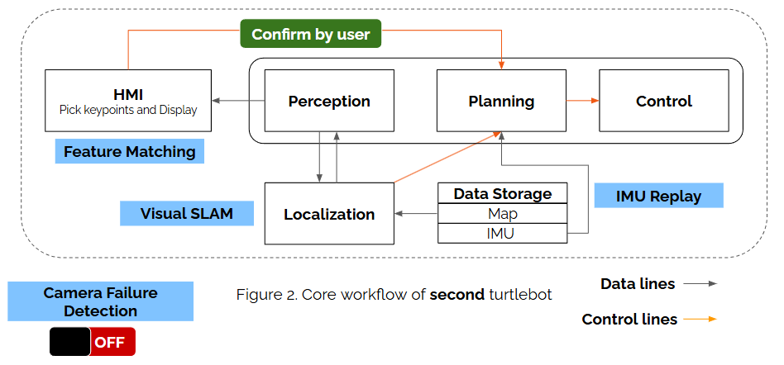
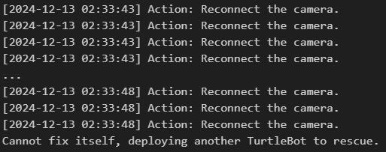
Camera Failure Detection
Blank frame detection
Frame Rate Monitoring
Overexposure/Underexposure
Camera connection

Slide 8
3D SLAM
Confirm by user
HMI
Pick keypoints and Display
Perception
Planning
Control
Feature Matching
Localization
Data Storage
IMU Replay
Visual SLAM
Map
IMU
Data lines
Camera Failure Detection
Figure 2. Core workflow of second turtlebot
Control lines
OFF
Notes:
[System design and operation diagram]

Slide 9
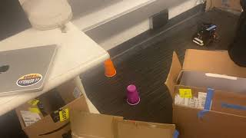
3D SLAM
Maps the environment and records its position.
Uses SLAM to locate itself when placed randomly.
Navigate to Endpoint.

Slide 10
IMU Navigation
Confirm by user
HMI
Pick keypoints and Display
Perception
Planning
Control
Feature Matching
Localization
Data Storage
IMU Replay
Visual SLAM
Map
IMU
Data lines
Camera Failure Detection
Figure 2. Core workflow of second turtlebot
Control lines
OFF
Notes:
[System design and operation diagram]

Slide 11
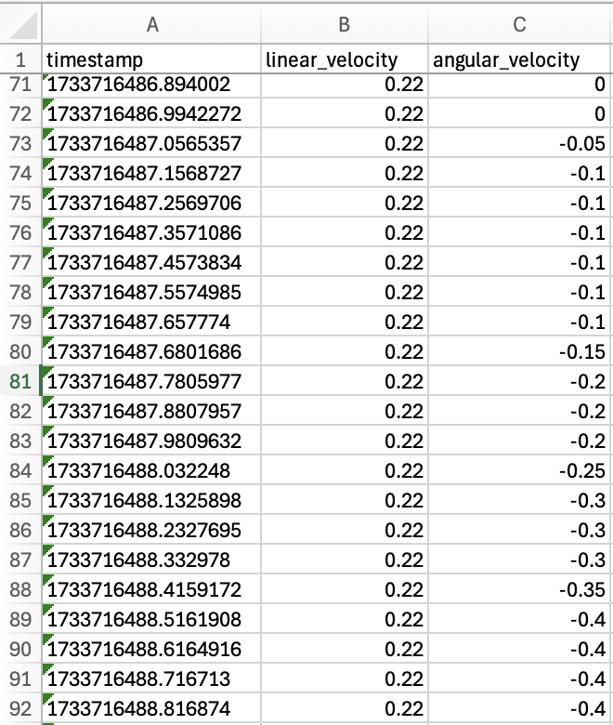
IMU Navigation
Record & Replay

Slide 12
Key Point Matching
Confirm by user
HMI
Pick keypoints and Display
Perception
Planning
Control
Feature Matching
Localization
Data Storage
IMU Replay
Visual SLAM
Map
IMU
Data lines
Camera Failure Detection
Figure 2. Core workflow of second turtlebot
Control lines
OFF
Notes:
[System design and operation diagram]

Slide 13
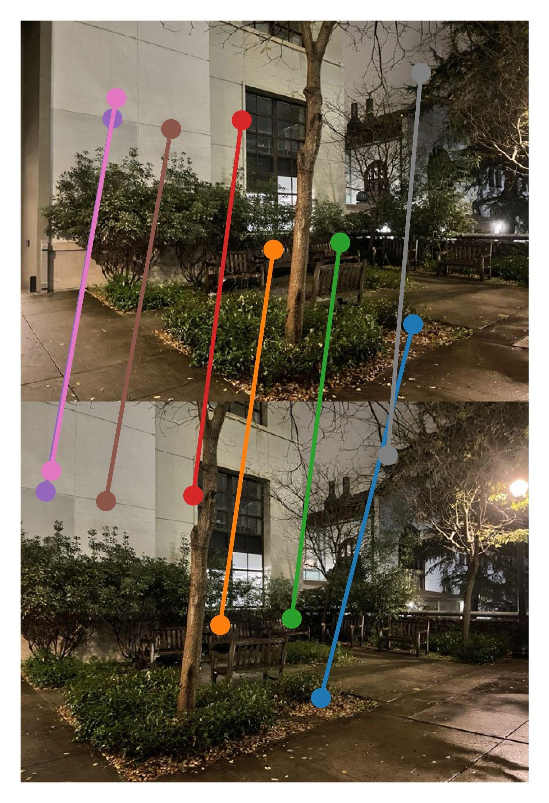
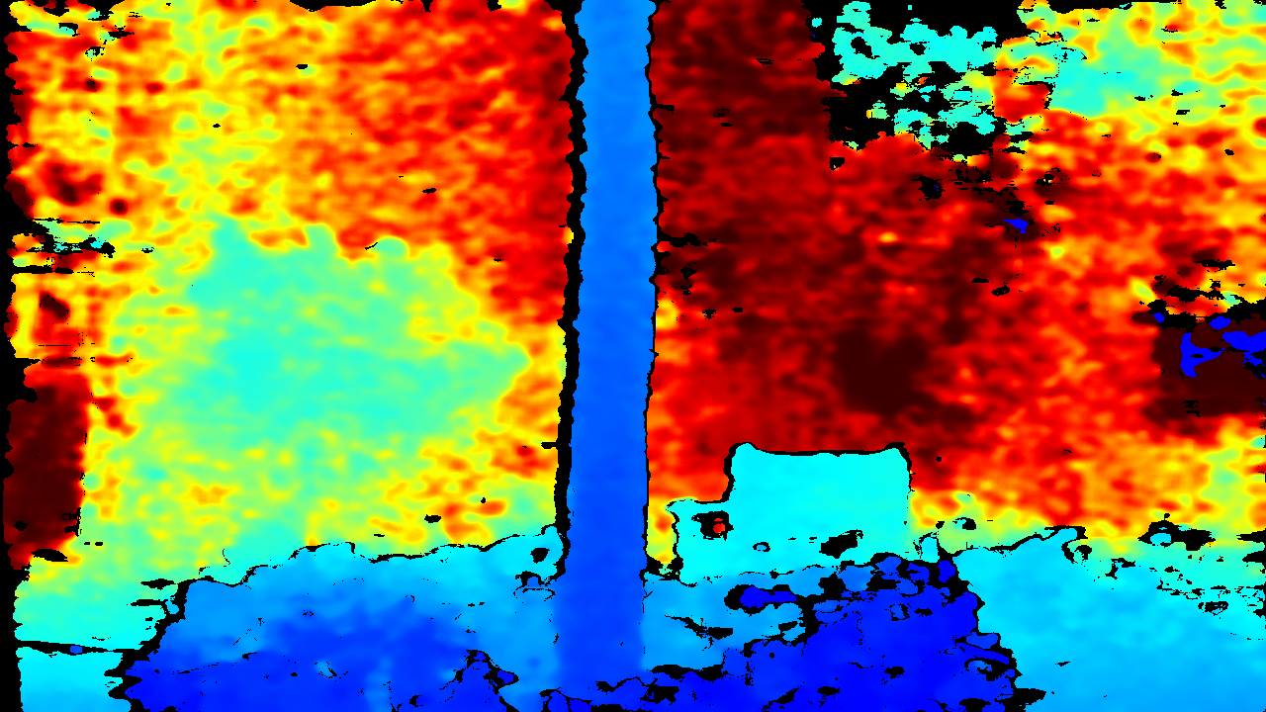
Key Point Matching
Works well outside.
Helps recover from IMU errors.
Key Features
Uses two layers of filtering (RANSAC and Lowe’s)
Uses ANMS to distribute points evenly.
Uses point cloud and essential matrix to calculate transformation.

Slide 14
Difficulties
Using SLAM with the LiDAR proved insufficient for accurate self-localization, often failing to determine its position relative to the map.
Turtlebot needs to explore the map thoroughly to localize accurately when placed randomly.
Initially proposed WiFi navigation works not so good because of the WiFi echo noise, we are trying to do sensor fusion as an alternative.
Noise in IMU data causes Turtlebot doesn’t move accurately with low velocity or high acceleration.

Slide 15
What can be expected
Keyframe-based Navigation: Implement a keyframe-based approach to navigate the TurtleBot.
Sensor Fusion: Combine IMU and visual data from videos to improve navigation accuracy.
Robust Error Handling: Being able to identify the moving objects and extracting features from static objects in the environment (PCA).
Beacon Based Navigation: Use a IR beacon (like the LIDAR) to find direction of broken turtlebot
Smaller Dim, Higher Res Depth: Use a LIDAR module that takes a higher resolution image of a smaller area.

Slide 16
Contributions
① Scout
Camera Failure Detection
② Rescuer
IMU Record & Replay
Visual SLAM
Feature Matching

Slide 18
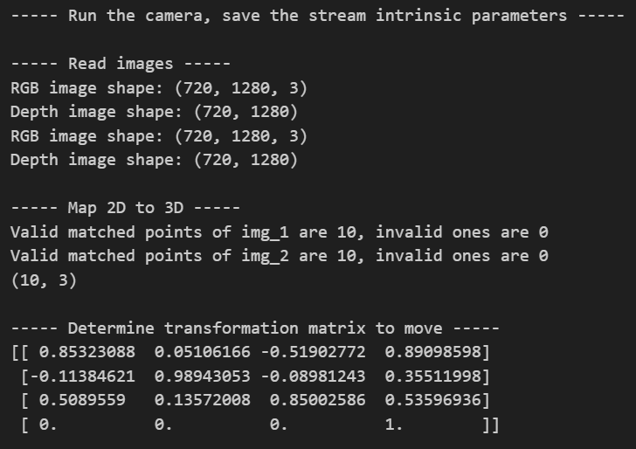
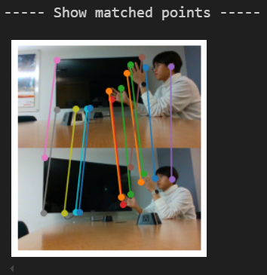
Supporting Material

